Slide 1
Chapter 14: Basics of Functional Dependencies and Normalization for Relational Databases (cont.)

Slide 2
Introduction to 3NF
Lecture 5 > Section 1 > Overview
Consider the following relation Employee2:
Employee2(SSN, FName, LName, DNumber, DName, MgrSSN)
key: SSN
Functional dependencies:
SSN → FName, LName, DNumber
DNumber → DName, MgrSSN
The relation Employee2 represents information of the employees, the departments and the Manager

Slide 3
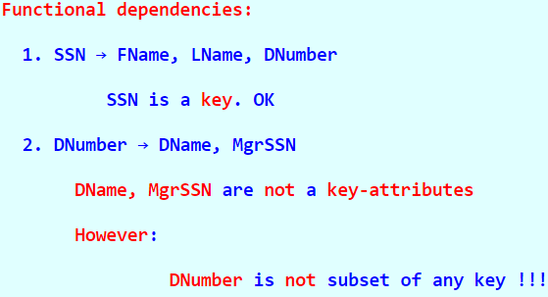
Introduction to 3NF (cont.)
Lecture 5 > Section 1 > Overview
Question:
Is the relation Employee2 in 2NF ?
Conclusion:

Slide 4
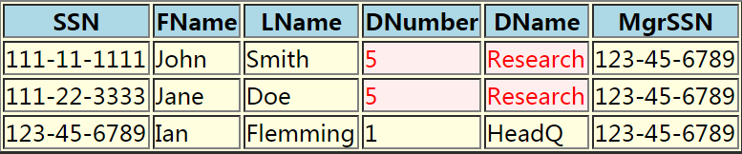
Introduction to 3NF (cont.)
Lecture 5 > Section 1 > Overview
Sample content of the Employee2 relation:
Good or bad design?
Observe the duplication of information highlighted in the content

Slide 5
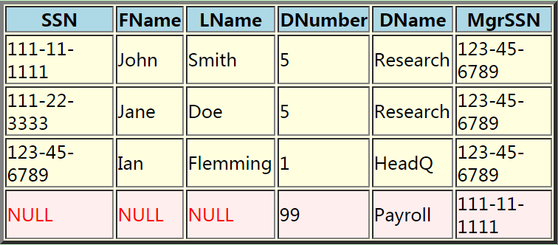
Introduction to 3NF (cont.)
Lecture 5 > Section 1 > Overview
Relation Employee2 clearly exhibits anomalies:
Insert anomaly: insert a new department requires NULL values

Slide 6
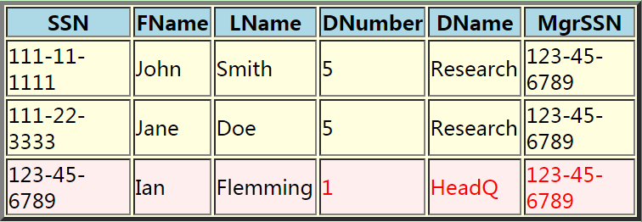
Introduction to 3NF (cont.)
Lecture 5 > Section 1 > Overview
Delete anomaly: deleting the employee "Ian Flemming" will also delete information on department "HeadQ"

Slide 7
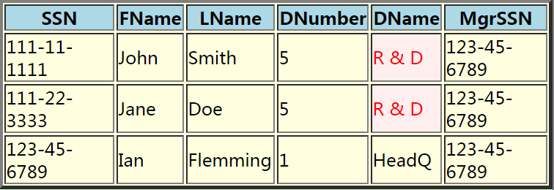
Introduction to 3NF (cont.)
Lecture 5 > Section 1 > Overview
Update anomaly: changing a single item of information - such as the department name from "Research" to "Research and Development" - will update multiple tuples

Slide 8
Introduction to 3NF (cont.)
Lecture 5 > Section 1 > Overview
Conclusion:
“The 2NF can help us to identify some poorly designed relations, but not all of them....”

Slide 9
The 3NF: A bit of History
Lecture 5 > Section 1 > Overview
The 3NF:
The original intention of the 3NF deals with the so-call transitive dependencies
Later, we discovered another way to describe the 3NF ....
So I will first give the 3NF in the intuitive form and show you how they arrived at the final form....

Slide 10
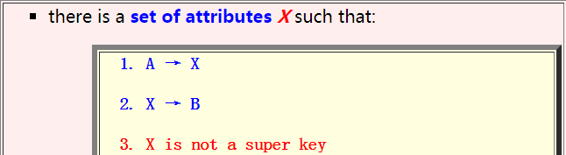
The 3NF: Transitive Functional Dependencies
Lecture 5 > Section 1 > Overview
A relation R is in 3NF iff:
R is in 2NF , and
Every non-key attribute is non-transitively dependent on all the keys
Transitive functional dependency:
A functional dependency A → B is a transitive functional dependency in a relation R if:
Ssn → Dnumber
Dnumber → Dmgr_ssn
Ssn → Dmgr_ssn
Notes:
Intuitively, if a relation schema corresponds to one entity type or one relationship type, it is straightforward to explain its meaning.

Slide 11
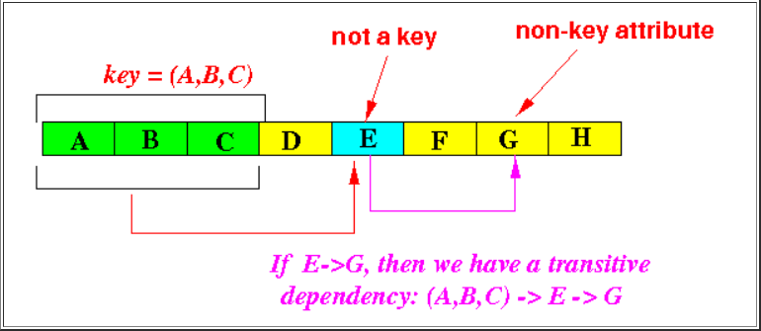
How to Detect 3NF Violations
Lecture 5 > Section 1 > Overview
The following figure shows you how to spot a 3NF violation:
(A,B,C) is a key:
Clearly, (A,B,C) → any attribute in R
Look for a functional dependency E → G where:
E is not a key
then there is a transitive functional dependency in the relation.

Slide 12
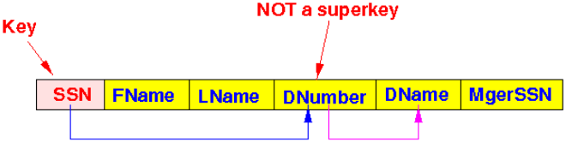
How to Detect 3NF Violations (Example)
Lecture 5 > Section 1 > Overview
Employee2(SSN, FName, LName, DNumber, DName, MgrSSN)
Key(s): SSN
Functional dependencies:
SSN → FName, LName, DNumber
DNumber → DName, MgrSSN
Ssn → Dnumber
Dnumber → Dname
Ssn → Dname

Slide 13
A More Simpler Definition of 3NF
Lecture 5 > Section 1 > Overview
Recall: a relation R is in 3NF iff:
R is in 2NF
Which means:
Every non-key attribute B is non-transitively dependent on all the keys
We will re-formulate these 2 conditions

Slide 14
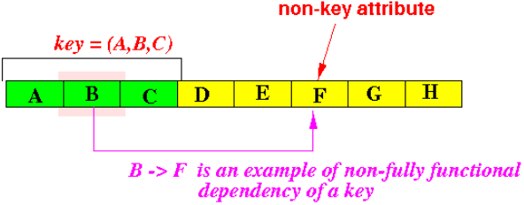
Re-Formulating the 2NF Condition
Lecture 5 > Section 1 > Overview
Let us examine/re-state the 2NF condition:
The functional dependency B → F will cause a 2NF violation:
If
The attributes B is (must be) a subset of a key, and
The attribute F is not a key attribute

Slide 15
Re-Formulating the 2NF Condition (cont.)
Lecture 5 > Section 1 > Overview
Therefore: there is no 2NF violation if (see above figure):
The attributes B is not a subset of some key or
The attribute F is a key attribute (i.e., part of some key)
Re-phrased:
The attribute B is a superset of some key or
The attribute F is a key attribute (i.e., part of some key)

Slide 16

Re-Formulating the 2NF Condition (cont.)
Lecture 5 > Section 1 > Overview
Therefore: a relation R is in the 2NF:
For every function dependency in R: B → F, the following must hold:

Slide 17
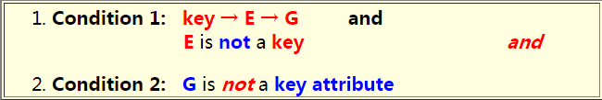
Re-Formulating the Additional 3NF Condition
Lecture 5 > Section 1 > Overview
Let us examine/re-state the transitive functional dependency condition:
A functional dependency E → G will cause a 3NF violation
If:

Slide 18
Re-Formulating the Additional 3NF Condition (cont.)
Lecture 5 > Section 1 > Overview
Since:
key → E is true for every key, and
E → G is given
We can simplify the conditions to:
Condition 1: E is not a key and
Condition 2: G is not a key attribute

Slide 19
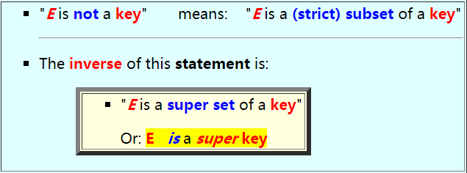
Re-Formulating the Additional 3NF Condition (cont.)
Lecture 5 > Section 1 > Overview
Conversely, a functional dependent E → G will not cause a 3NF violation if::
E is a superkey, or
The attribute G is a key attribute
Note:

Slide 20

Re-Formulating the Additional 3NF Condition (cont.)
Lecture 5 > Section 1 > Overview
Therefore, the transitive functional dependency condition can be re-stated as follows:
For every functional dependency in R, E → G, the following must hold:

Slide 21

A Simple Definition for 3NF
Lecture 5 > Section 1 > Overview
A relation R is in 3NF:
For every functional dependency X → B in relation R, one of the following must be true:
If one of the above is true, then the functional dependency is "good" (= harmless))

Slide 22
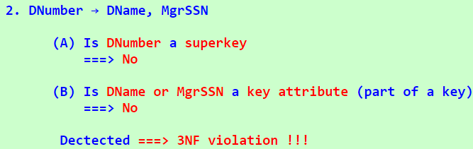
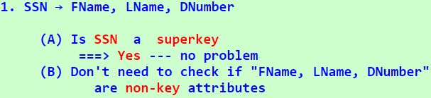
Example of Detecting 3NF Violations
Lecture 5 > Section 1 > Overview
Employee2(SSN, FName, LName, DNumber, DName, MgrSSN)
With functional dependencies:
SSN → FName, LName, DNumber
DNumber → DName, MgrSSN
The key are SSN
Check each functional dependencies:

Slide 23
Decomposition to the 3NF
Lecture 5 > Section 1 > Overview
Removing 3NF violation: decomposition
If you find a functional dependency X → B that causes 3NF violation, i.e.,
X is not a superkey and
B is a non-key attribute (i.e., not part of any key)

Slide 24
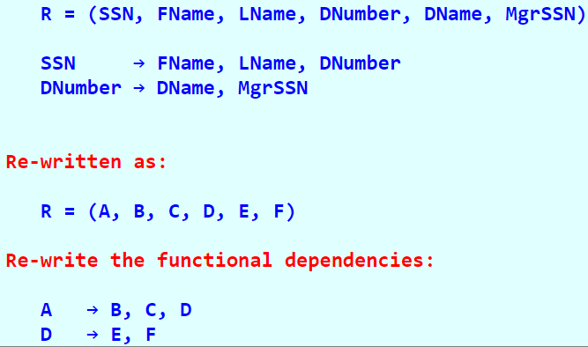
Example of Decomposing a Relation into 3NF
Lecture 5 > Section 1 > Overview
To make things more interesting, let us try to decompose the Employee2 relation using abstract attribute names
We re-write the attribute names with meaningless letters:

Slide 25

Example of Decomposing a Relation into 3NF (cont.)
Lecture 5 > Section 1 > Overview
What we do following:
For every functional dependency X → Y:
If we get no and no as answers, we found a violation

Slide 26
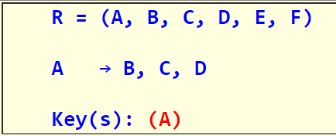

Example of Decomposing a Relation into 3NF (cont.)
Lecture 5 > Section 1 > Overview
Step 1: Check A → B, C, D
Information to make the 3NF decision:
Is A a super key?
Consider next functional dependency

Slide 27
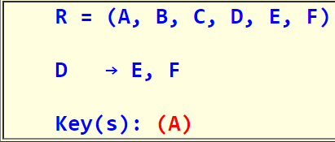


Example of Decomposing a Relation into 3NF (cont.)
Lecture 5 > Section 1 > Overview
Step 2: Check D → E, F
Information to make the 3NF decision:
Is D a super key?
Is E or F a key attribute?
3NF violation

Slide 28
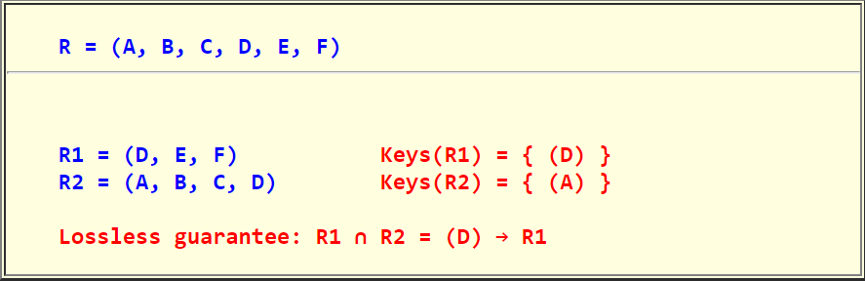
Decompose
Lecture 5 > Section 1 > Overview
Decompose R into:

Slide 29
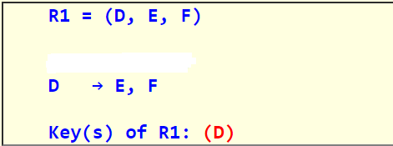

Check
Lecture 5 > Section 1 > Overview
Step 3: Check if R1 and R2 is in 3NF
Check R1
Information for 3NF decision
3NF decision:

Slide 30
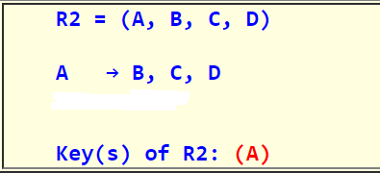

Check
Lecture 5 > Section 1 > Overview
Step 3: Check if R1 and R2 is in 3NF
Check R2
Information for 3NF decision
3NF decision:

Slide 31
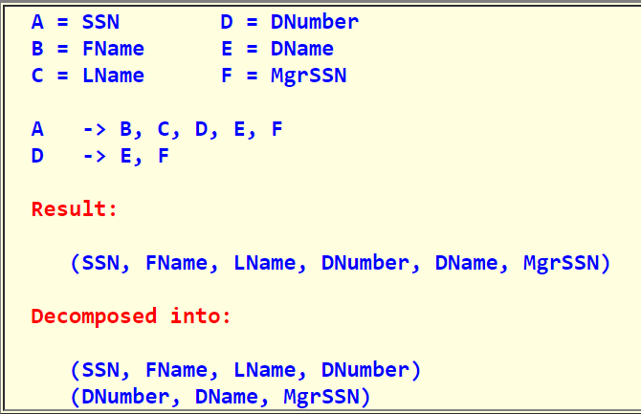
Done
Lecture 5 > Section 1 > Overview
Now, plug in the real world example
Check R2
Again, a set of very good relations....

Slide 32
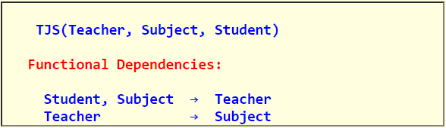
Introduction to Boyce-Codd Normal Form (BCNF)
Lecture 5 > Section 1 > Overview
Consider the following Teacher-Subject-Student database description
Each teacher teaches one subject
A subject can be taught by different teachers , i.e., there are multiple teachers per subject
Students takes classes in subjects
A (student, subject) pair identifies a teacher uniquely
The resulting relation and functional dependencies are:
The key of this relation are:
(Student, Subject)
(Student, Teacher)

Slide 33
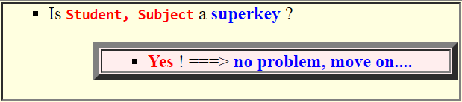
Introduction to Boyce-Codd Normal Form (BCNF)
Lecture 5 > Section 1 > Overview
Question:
Is this relation in the 3NF ???
Answer:
Check the functional dependency (Student, Subject) → Teacher:

Slide 34
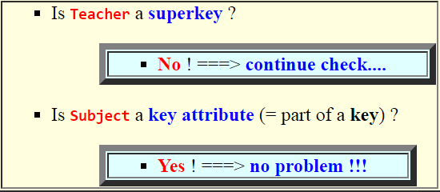
Introduction to Boyce-Codd Normal Form (BCNF)
Lecture 5 > Section 1 > Overview
Check the functional dependency Teacher → Subject:
Conclusion:

Slide 35
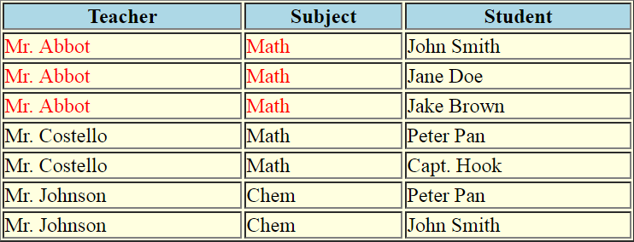
Introduction to Boyce-Codd Normal Form (BCNF)
Lecture 5 > Section 1 > Overview
Consider a sample content of the TJS relation
Observation:

Slide 36

Introduction to Boyce-Codd Normal Form (BCNF)
Lecture 5 > Section 1 > Overview
Historical background:
Boyce and Codd discovered this problem after Codd published the classic 1972 paper.
Boyce and Codd proposed a new 3NF which is known as the:

Slide 37

Definition of BCNF
Lecture 5 > Section 1 > Overview
A relation R is in Boyce-Codd Normal Form (BCND) iff
Every determinant (= LHS) of a functional dependency is a super key
A determine is the left-hand-side of a functional dependency
In other words:

Slide 38
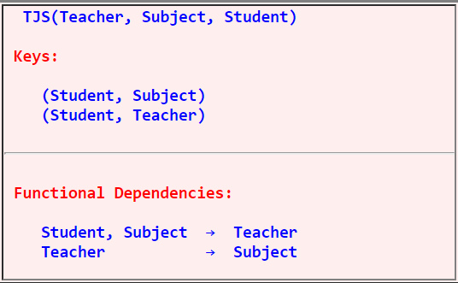
The Teacher-Subject-Student-Revisited
Lecture 5 > Section 1 > Overview
Recall:
Question: Is this relation in the BCNF ???

Slide 39

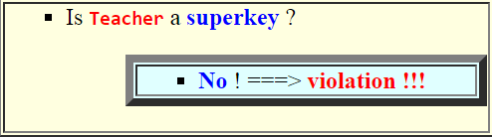
The Teacher-Subject-Student-Revisited
Lecture 5 > Section 1 > Overview
Answer:
Check the functional dependency Student, Subject → Teacher:
Check the functional dependency Teacher → Subject:
Conclusion:

Slide 40

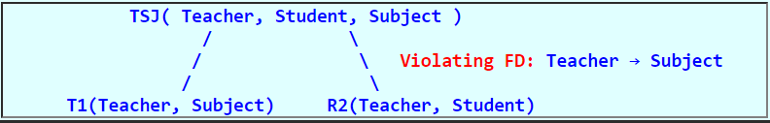
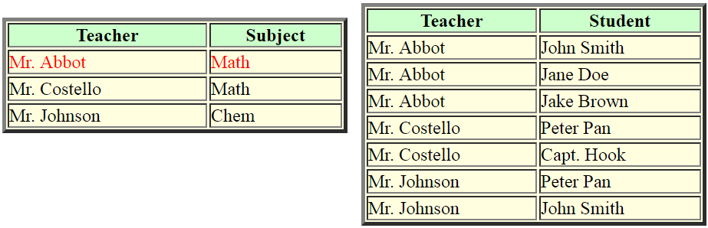
Decompose:
Lecture 5 > Section 1 > Overview
Decompose:
Original relation

